Slide 1
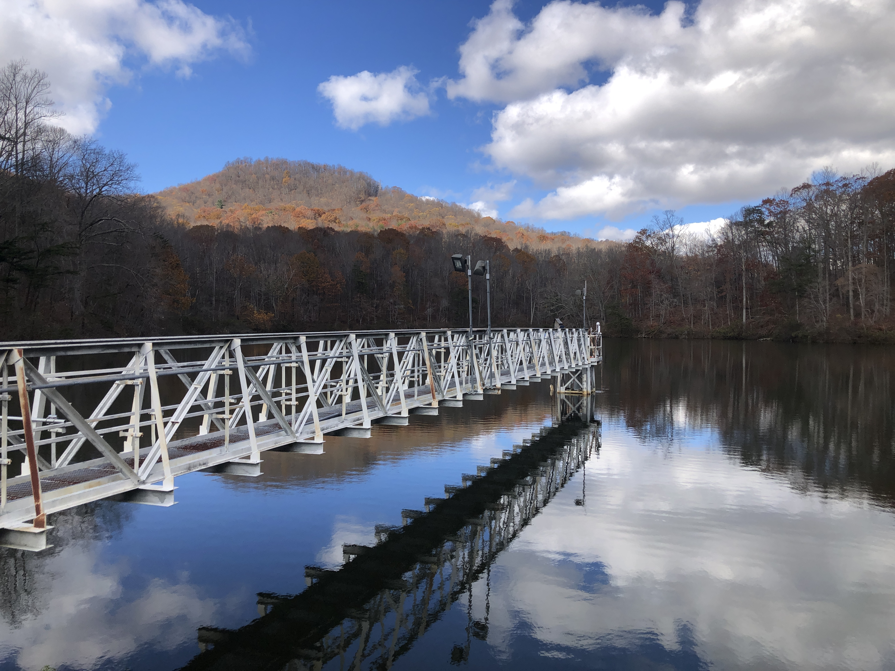
NEAR-TERM, ITERATIVE FORECASTS HIGHLIGHT THE RELATIVE IMPORTANCE OF TWO DRIVERS FOR DYNAMIC OXYGEN CONCENTRATIONS IN A DRINKING WATER RESERVOIR Abigail Lewis, Mary Lofton, Ryan McClure, Whitney Woelmer, Paul Hanson, Quinn Thomas, and Cayelan Carey
@lewis_lakes
Notes:
Hi, my name is Abby Lewis and today I am going to be talking about a project I led that used NEAR-TERM, ITERATIVE FORECASTS to understand OXYGEN dynamics IN A DRINKING WATER RESERVOIR

Slide 2
Ecological knowledge
Forecasting system
Ecological management
Notes:
*click*
In its most basic form, I think of ecological forecasting as using some level of ecological knowledge to develop a forecasting system, which can then be used to advance ecological management.
Through my work, I am really interested in thinking about a third arrow in this diagram, so how we can use forecasting applications as a tool to advance our ecological knowledge. That increased knowledge will then of course allow us to develop better forecasting systems and better management in the future.
So to start off this presentation, I am going to focus a bit on the ecological knowledge gap I am working to fill,
before discussing the forecasting framework I developed, including its management relevance.
Finally, I will circle back to describe how this forecasting system has helped us learn more about the fundamental nature of an ecological process.

Slide 3
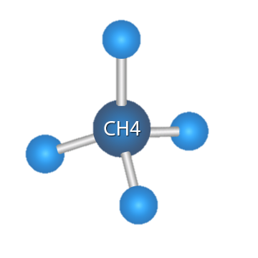
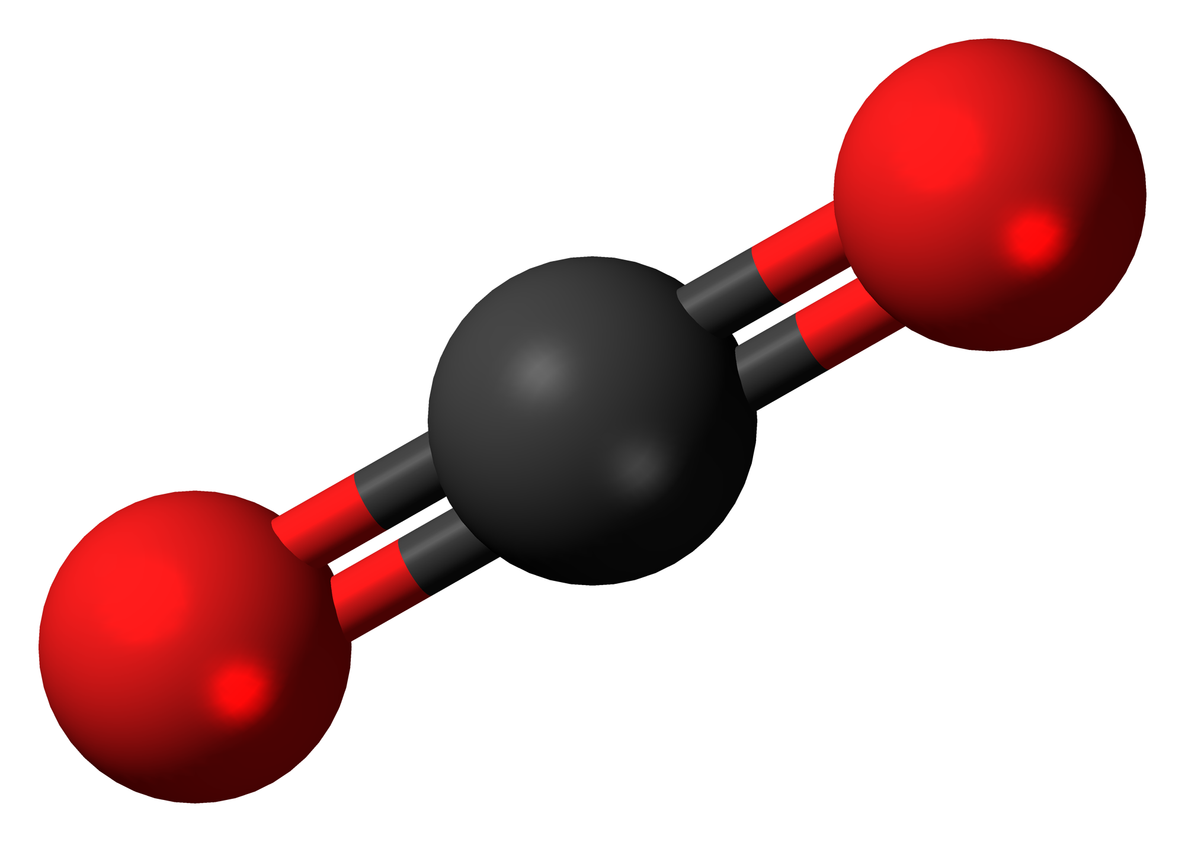
Lakes and reservoirs play an important role in both human well being and global ecological functioning
75% of human water use comes from rivers, lakes, and reservoirs
Reservoirs alone bury more carbon than ocean sediments each year (Dean and Gorham 1998; Knoll et al. 2013)
The extent to which reservoirs perform either of these functions depends on oxygen demand
CO₂
Notes:
My work is based in reservoirs, so I think it is important to start off by saying that freshwater lakes and reservoirs play an important role in both human well being and global ecological functioning.
75% of human water use comes from a combination of rivers, lakes, and reservoirs, so it is important that we conserve these freshwater resources.
Second, reservoirs play a critical role in the global carbon cycle. Each year, reservoirs around the world bury more organic carbon than all ocean sediments. This serves as an important and understudied ecological carbon sink.
The extent to which reservoirs are able to perform either of these important functions relates to the rate of oxygen consumption in the reservoir, which we call oxygen demand.
High rates of biological oxygen demand mean that more carbon is being mineralized, increasing GHG production and potentially increasing carbon emissions from reservoirs. High rates of oxygen demand can also cause oxygen concentrations to decrease to the point where you see deteriorating water quality or release of nutrients such as nitrogen and phosphorus which cause harmful algal blooms.

Slide 4


Previous research indicates oxygen demand is dependent on temperature and ambient oxygen concentrations, among other factors
O₂
Notes:
We know that a variety of factors can influence the rate of oxygen demand, including temperature and oxygen concentrations.
Temperature increases oxygen demand by accelerating biological and chemical processes that consume oxygen,
likewise increased oxygen availability can accelerate diffusion of oxygen into anoxic sediment and release oxygen limitation of bacterial respiration, all increasing the rate of oxygen demand

Slide 5




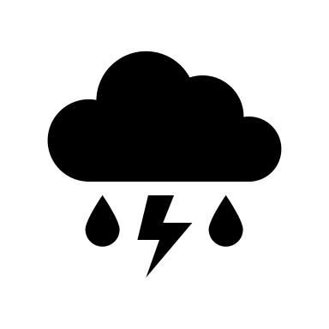
Changes in climate and land use are driving divergent trends in oxygen demand
[O₂]
O₂
[O₂]
Notes:
It is difficult to predict how the rate of oxygen demand will change over time in a given body of water, in part because changes in climate and land use are having divergent effects on oxygen demand.
Water temperatures in the upper layer of a lake or reservoir are generally increasing around the world, potentially increasing the rate of oxygen demand and decreasing oxygen concentrations.
At the same time, bottom-water temperatures are generally decreasing as a result of increased shading from dissolved organic carbon, which would decrease the rate of oxygen demand and lead to higher oxygen concentrations.
Finally, increased storm frequency and intensity can directly increase oxygen concentrations in lakes and reservoirs
In light of these heterogeneous changes, it is important that we understand the relative importance of temperature and oxygen concentrations as drivers as oxygen demand, so that we can predict how water quality and carbon cycling in reservoirs, will change over time.

Slide 6
Ecological knowledge
Forecasting system
Ecological management
How accurately can we forecast bottom-water oxygen conditions two weeks into the future using temperature and oxygen profiles?
Enable preventative management
Temperature and oxygen are commonly measured in lakes and reservoirs around the world
How does the relative importance of temperature and oxygen as drivers of bottom-water oxygen demand change over time?
Repeated hypothesis testing
Data-model fusion
Dynamic model parameters
Notes:
*Click twice*
In this study we aimed to answer two questions: first,
how accurately can we forecast hypolimnetic oxygen conditions two weeks into the future using temperature and oxygen profiles?
Answering this question would enable preventative management of reservoir ecosystems, as managers can take steps to prepare for or prevent the water quality problems that arise when oxygen concentrations decrease. Furthermore, temperature and oxygen are commonly measured in lakes and reservoirs around the world, and creating a model based on only these two variables would address a widely cited need for oxygen models that don’t require extensive data collection, or data with high latency including dissolved organic carbon and nutrient concentrations.
The second question I aimed to address is: how does the relative importance of temperature and oxygen as drivers of hypolimnetic oxygen demand change over time?
Near-term ecological forecasting provided a useful framework for answering this fundamental ecological question, by allowing for repeated hypothesis testing, data-model fusion that combined the strengths of data availability and existing knowledge incorporated in a model, and dynamic model parameters that reflect real-world processes on a whole ecosystem scale

Slide 7
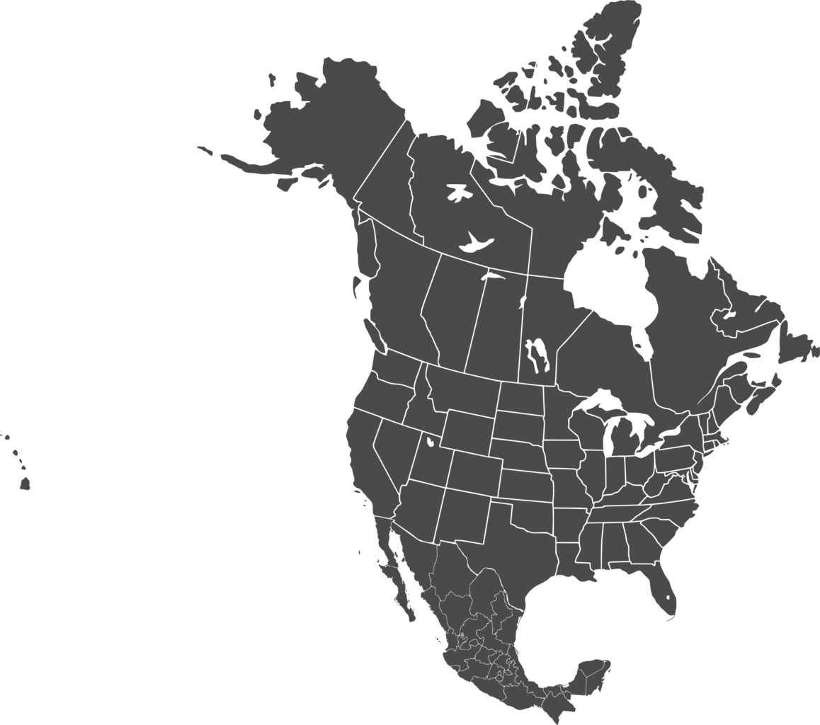

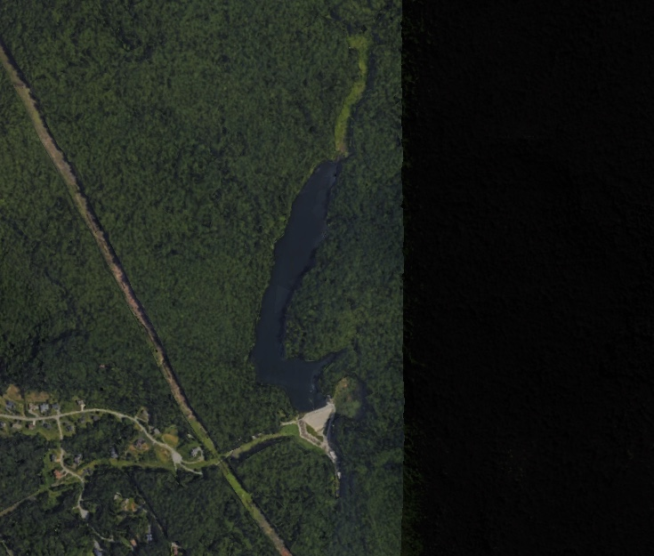
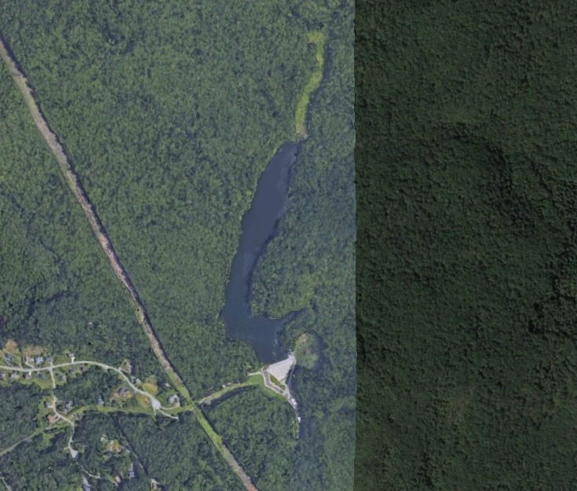
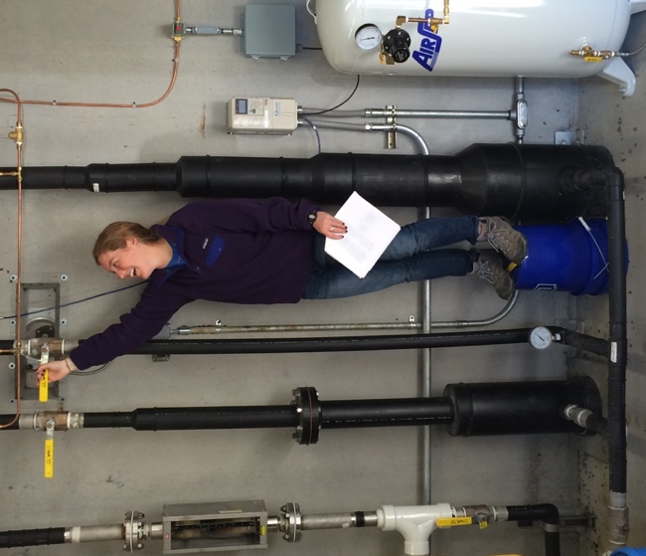

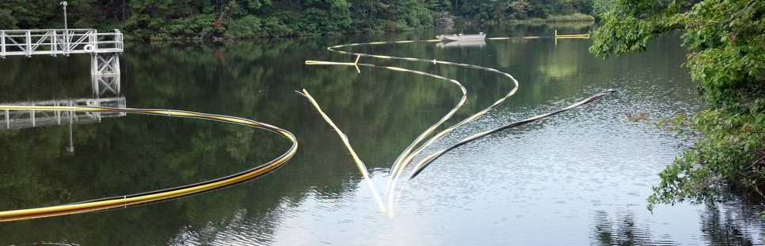
Six years of oxygenation have provided a unique opportunity to analyze these factors on a whole-ecosystem scale
Falling Creek Reservoir
1 km
Notes:
To develop my forecasting framework, I used historical time series data from Falling Creek Reservoir, located in southwest Virginia.
Falling Creek is equipped with an oxygenation system that can add oxygen to bottom waters of the reservoir without decreasing thermal stability. The oxygenation system operates at the bottom of the reservoir, but in this photo on the bottom here we had a perfect photo opportunity when we brought the system up to the surface for maintenance. Oxygenation can be turned on an off on demand by scientists and managers, as shown in the picture above.
Starting in 2013, this oxygenation system has been operated on a variable schedule, providing a perfect dataset that disentangles seasonal correlations between oxygen concentrations and temperatures, helping us isolate the separate impacts of oxygen and temperature on oxygen demand.

Slide 8

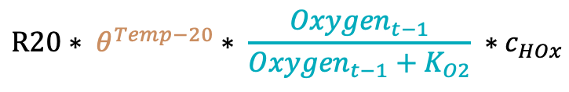
Simple model structure facilitates process representation without intensive parameterization
Oxygenation System (HOx)
Oxygen Demand
O₂
O₂
O₂
$${Oxygen}_{t}={Oxygen}_{t−1}+HOx −oxygen demand$$
$$R20∗ θ^{Temp−20}∗ \frac{{Oxygen}_{t−1}}{{Oxygen}_{t−1}+K_{O2}} ∗c_{HOx}$$
Notes:
I developed my forecasting system based on a simple, process-based model. In this model, Oxygen at time t is equal to oxygen at time t-1 plus oxygen addition by the hypolimnetic oxygenation system and minus oxygen consumed through demand.
Oxygen demand was modeled using a coefficient that can vary over the course of the summer, an exponential term for temperature, and monod kinetics for dissolved oxygen. The model also includes a scalar increase in oxygen demand when the oxygenation system is activated which has been documented in other studies and results from increased turbulence at the sediment water interface.

Slide 9
Ensemble Kalman Filter forecasting framework facilitates data assimilation, parameter updating, and uncertainty quantification
1. Create 14-day ensemble forecasts
2. Check if new observations are available
3. Update parameters and state estimates
Initial conditions | Drivers | Parameters | Process
Today (t)
Tomorrow (t + 1)
t + 2
…
t + 14
Oxygen
Temperature
Oxygen
Oxygen
Oxygen
Temperature
Temperature
Temperature
Oxygenation
Oxygenation
Oxygenation
Oxygenation
Notes:
I used this model to develop iterative forecasts over six years of data. Forecasts were developed retroactively, but they only use data that was available at date of the forecast.
The first step in this iterative forecasting workflow was to create 14-day ensemble forecasts of dissolved oxygen. In this study, I used 100 ensemble members, and variation between those ensemble members resulted from stochastically generated initial conditions, drivers, parameters, and process error.
I think the easiest way to visualize how we created 14-day predictions is through this table. Imagine we took oxygen and temperature measurements today, and we want to know what the oxygen concentration will be 14 days in the future. For the sake of this study, we assumed that the oxygenation pattern is known in advance, because the system can be manipulated on demand by scientists and managers.
Using oxygen, temperature, and oxygenation today, we can model what oxygen concentrations will be tomorrow. To predict oxygen two days in the future we also need to know the temperature today, so we forecasted temperature using a very simple linear increase from the previous day, with the slope of that increase equal to the average increase in temperature in a training dataset. Following the same pattern, we can then create predictions two days in the future and so on until we have a prediction for day 14.
The next day, our forecasting workflow, checks if new observations are available. If so, it uses the ensemble kalman filter to assimilate that observation, updating the current temperature and amount of oxygen in the reservoir, and adjusting parameters based on which ensemble members created the most accurate forecasts. Finally, the cycle repeats, with the forecasting framework making a new 14-day ensemble forecast

Slide 10
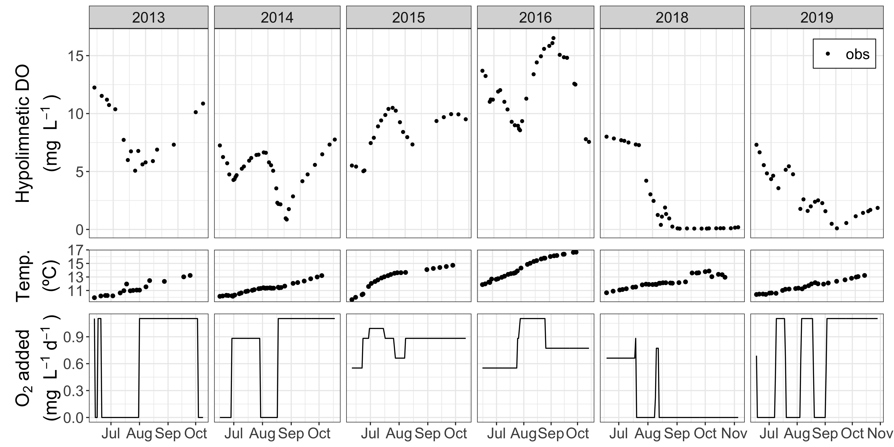
Notes:
So I am now going to present the data that were used to create these forecasts, before adding in the forecast output. In this graph, each facet is a different year, and the x axis gives dates throughout the course of the stratified period in that year. You will notice that 2017 is not included, and this is because data was not available for most of that year. On the y axis we have the rate of oxygenation in mg per liter of the bottom waters of the reservoir per day, and you can see that the dataset includes a wide range of oxygen addition rates, as well as varying oxygenation patterns each year.

Slide 11
Notes:
Temperatures in the bottom waters of the reservoir increased more or less linearly over the course of the summer each year, and the contrasting patterns between temperature and oxygenation helped us disentangle the influence of temperature and oxygen on oxygen demand.

Slide 12
Bottom-water oxygen
Notes:
Finally, oxygen values ranged between 0 and 16 mg/L showing clear responses to bottom-water oxygenation. For example, in 2013 you can see that while the oxygenation system was off oxygen concentrations decreased, but when the oxygenation system was activated oxygen concentrations start to increase

Slide 13
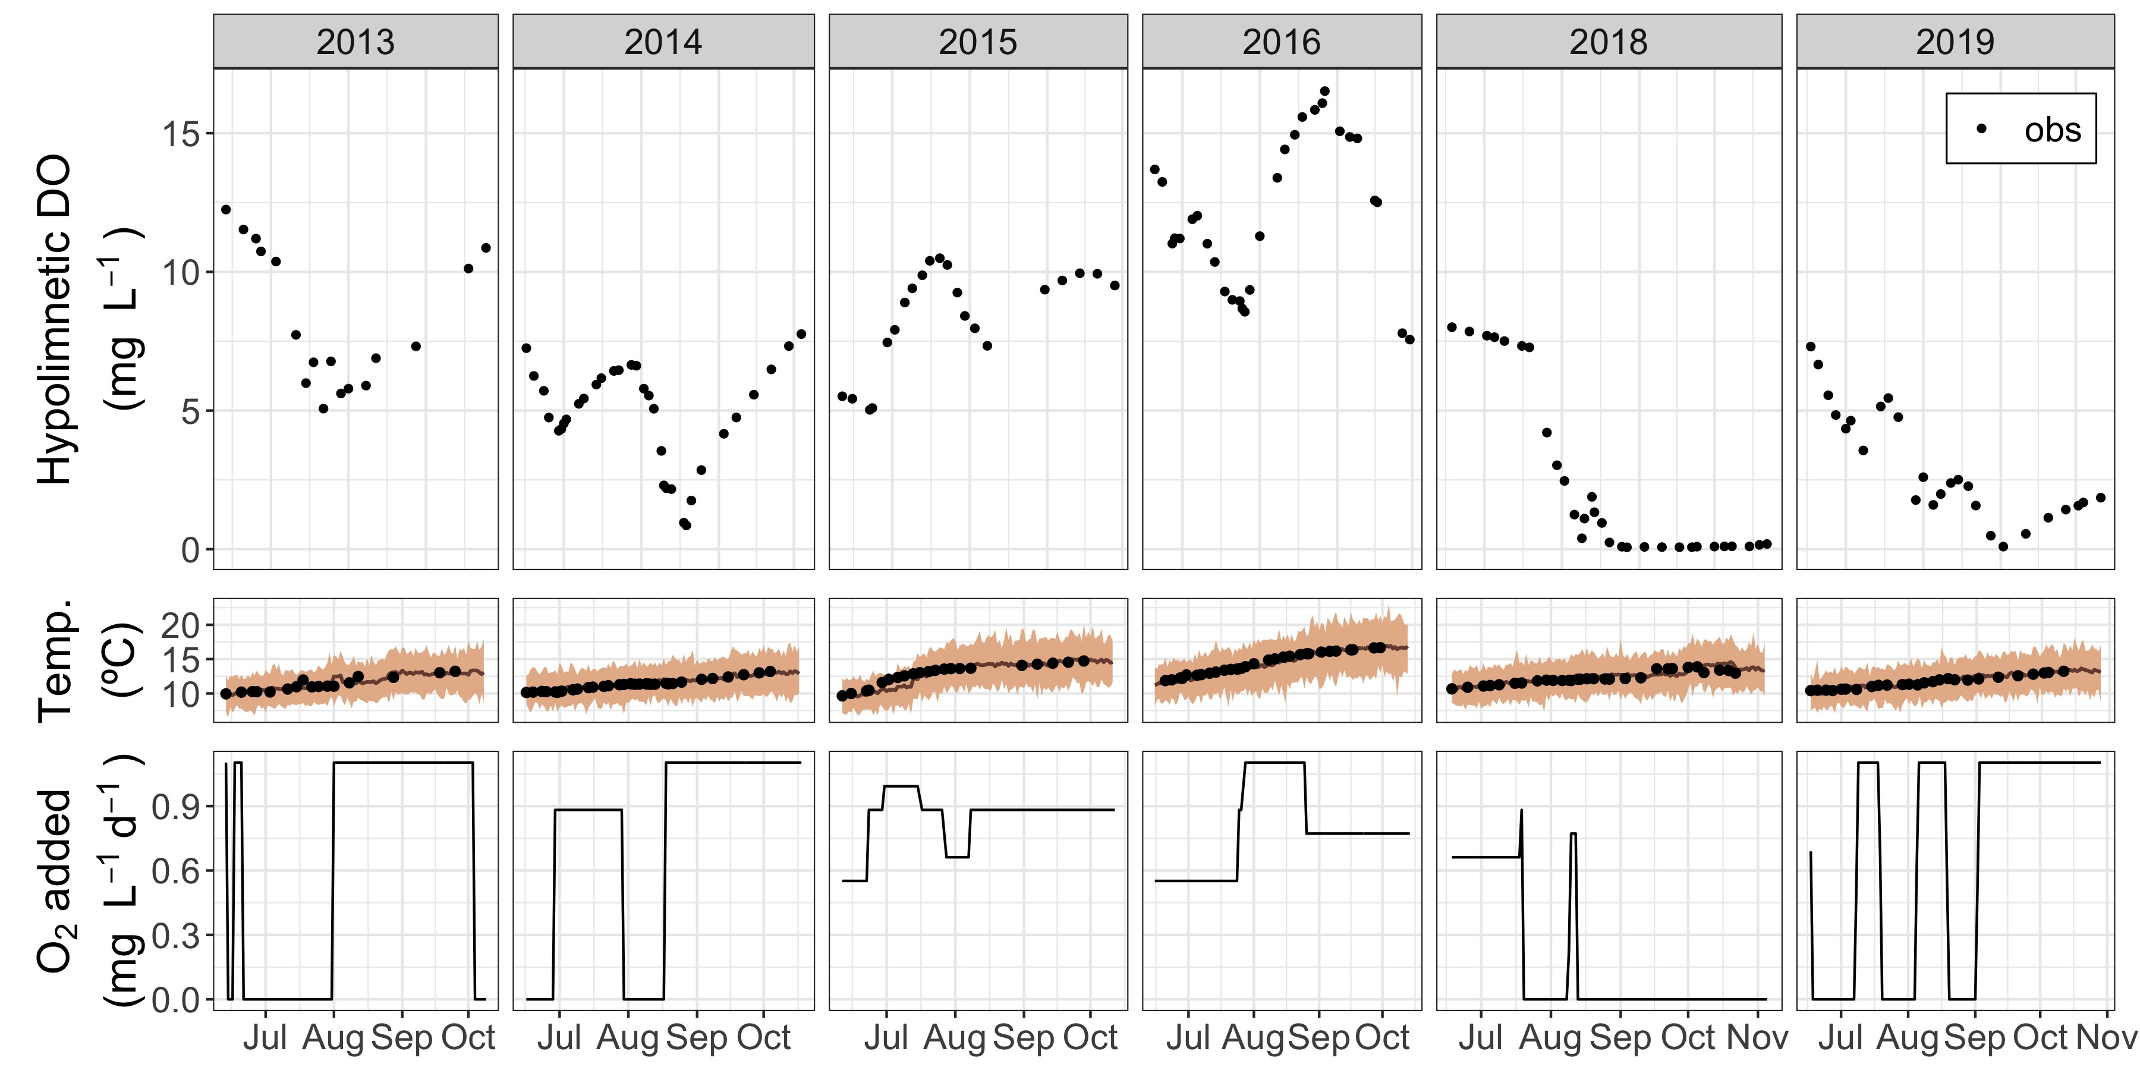
Bottom-water oxygen
Notes:
Here, I have added in my 14-day temperature forecasts which were used to drive the oxygen forecasts

Slide 14
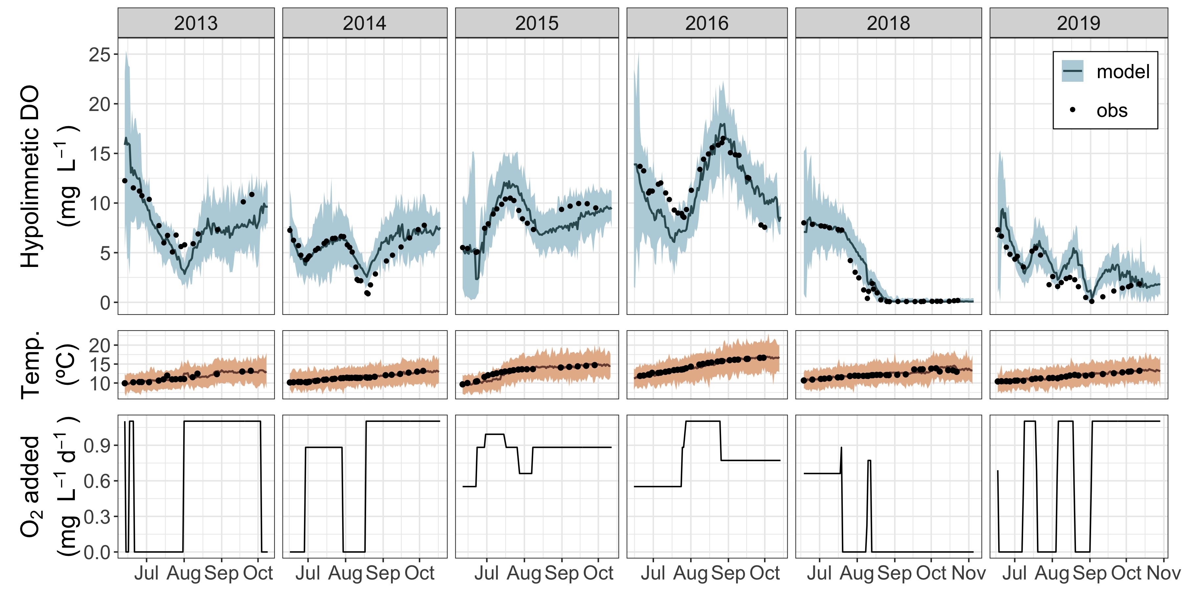
Bottom-water oxygen
Notes:
And finally, here are the 14-day oxygen forecasts in the top panel. You can see that the model generally does well at recreating patterns in oxygen concentrations over time.

Slide 15
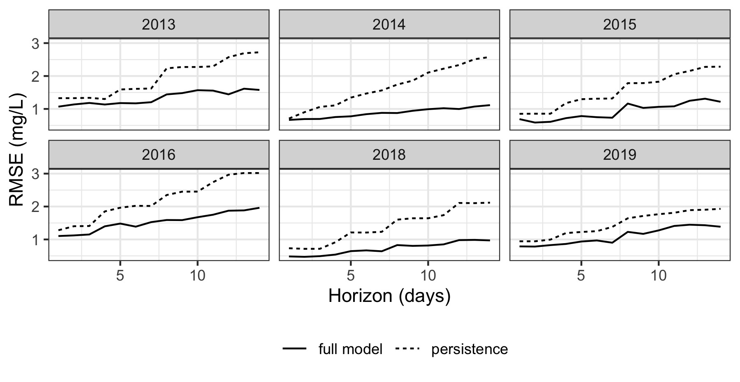
Forecast outperforms a persistence null model two weeks into the future
RMSE of other published oxygen models: 2.34 – 3.31 mg/L
(Farrell et al. 2020; Ladwig et al. 2020)
Notes:
As one form of evaluation for this forecasting framework, I compared forecasts to a persistence null model which predicts that oxygen concentrations in the future will be equal to the last oxygen measurement. If the forecast is not better than the null model that means the model has effectively no skill, and it is not worth using this model to understand ecosystem processes. However, in this case, my forecasts had lower root mean squared error than the null model at all forecast horizons across all years.
Furthermore, these RMSE values are lower than those reported in previous oxygen modeling studies, indicating that these forecasts do quite well despite using a simple model based on temperature and oxygen alone.

Slide 16
How accurately can we forecast bottom-water oxygen conditions two weeks into the future using only temperature and oxygen profiles?
How does the relative importance of temperature and oxygen as drivers of oxygen demand change over time?
Notes:
So this first part of the presentation was focused on the question: How accurately can we forecast bottom-water oxygen conditions two weeks into the future using only temperature and oxygen measurements? We found that oxygen was predictable within 2 mg/L using a simple process-based model. The simple model structure and low data requirements suggest that this forecasting framework may be able to easily aid in the management of lakes and reservoirs around the world.
Next, we used this forecasting framework to analyze how the relative importance of two drivers may change over time

Slide 17
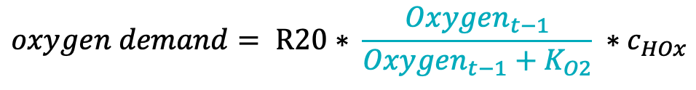
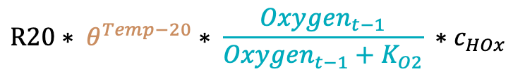
Alternative model structures test the importance of two drivers of oxygen demand
Full model
Oxygenation System
Oxygen Demand
$${DO}_{t}={DO}_{t−1}+HOx −oxygen demand$$
O₂
O₂
O₂
$$R20∗ θ^{Temp−20}∗ \frac{{Oxygen}_{t−1}}{{Oxygen}_{t−1}+K_{O2}} ∗c_{HOx}$$
Temperature-only model
Oxygen-only model
$$oxygen demand= R20∗ \frac{{Oxygen}_{t−1}}{{Oxygen}_{t−1}+K_{O2}} ∗c_{HOx}$$
$$oxygen demand= R20∗ θ^{Temp−20} ∗c_{HOx}$$
Notes:
To understand the dominant drivers of oxygen demand, I took the original model that contained sensitivity to both temperature and oxygen, and I divided it into two separate models. The temperature-only model included temperature as a driver, but not oxygen concentrations, and the oxygen-only model included oxygen as a driver, but not temperature. I then compared the relative performance of forecasts based on each of these models across the six-year time series to assess when each driver is most important

Slide 18
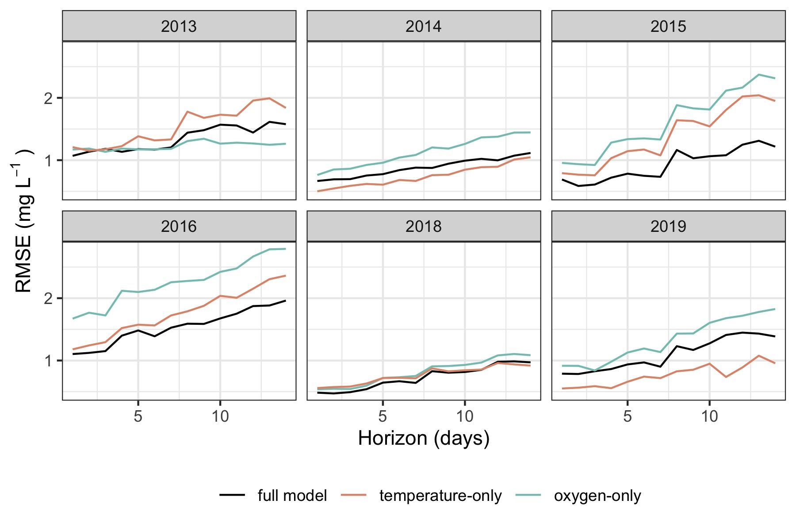
Temperature-only forecast generally (but not universally) outperforms the oxygen-only forecast
Notes:
This figure is very similar to the evaluation plot I showed earlier, with RMSE on the y axis and forecast horizon on the x axis. Here you can see that the temperature only model has a lower RMSE than the oxygen-only model in every year except 2013, and furthermore the temperature only model outperforms the full model in 2014 and 2019. Based on these results, temperature appears to generally play a more important role in determining the rate of oxygen demand than oxygen concentrations.

Slide 19
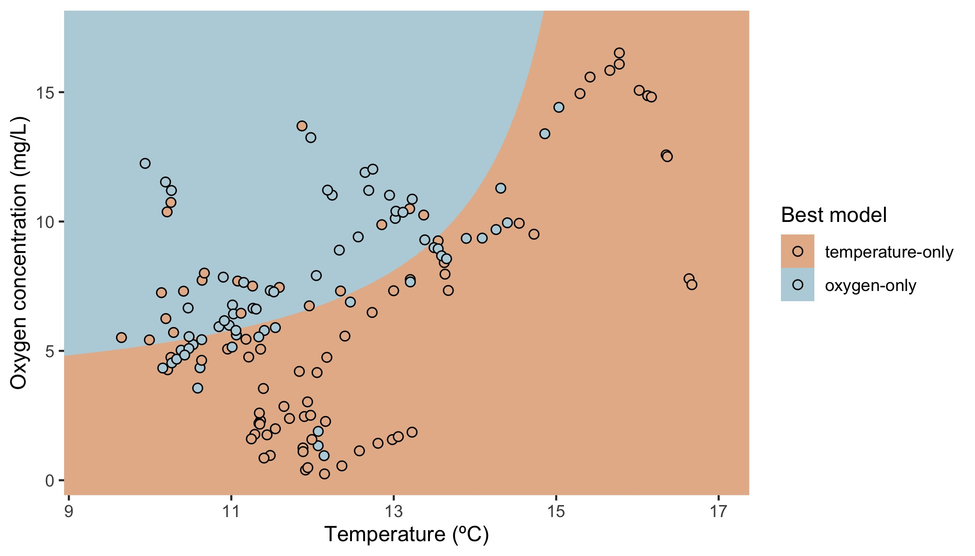
Oxygen-only model is best at low temperatures and high oxygen concentrations
Oxygen concentrations > 0.2 mg/L omitted from graph
Notes:
Despite the fact that temperature does better on average, there are certainly instances where the oxygen-only model outperforms the temperature-only model. To understand more about the circumstances under which each model performs best, I related the relative performance of these models to a variety of other aspects of the reservoir ecosystem, including nutrient concentrations, DOC concentrations, temperature, and oxygen. What came out most strongly is that the temperature only model tends to perform best at high temperatures and low oxygen concentrations, while the oxygen-only model does well at low temperatures and high oxygen concentrations.
In this figure, the points show observations from this study, while the background color shows the predictions of a linear model relating relative model performance to temperature and oxygen concentrations.
The fact that temperature is a particularly important driver of oxygen demand at high temperatures is intuitive based on the exponential relationship between temperature and oxygen demand. As temperature increases, it exerts an increasingly strong influence over the rate of oxygen demand and quickly becomes essential to include in a model of changing oxygen concentrations. The fact that the oxygen-only model performed better at high oxygen levels when temperatures were low may indicate that on a whole-ecosystem scale, high oxygen concentrations play an important role in enhancing respiration, leading to greater oxygen demand. This comparison is only possible due to the use of near-term iterative forecasting, which allowed us to repeatedly test these alternative hypotheses as new data comes in.

Slide 20
Ecological knowledge
Forecasting system
Ecological management
Notes:
So in this project I was really interested in not only developing a forecasting framework that could be used for ecological management, but also thinking about how we can use that forecasting framework to shed light on the underlying processes behind oxygen demand in a drinking water reservoir.
As I have discussed in this presentation, the forecasting system was reasonably successful in predicting future oxygen concentrations two weeks in advance, and temperature was the most important driver of oxygen demand, particularly at high temperatures and low oxygen concentrations.
Near-term ecological forecasting provided a useful framework for answering this ecological question, by allowing for repeated hypothesis testing, data-model fusion, and dynamic model parameters that reflect real-world processes on a whole-ecosystem scale.

Slide 21
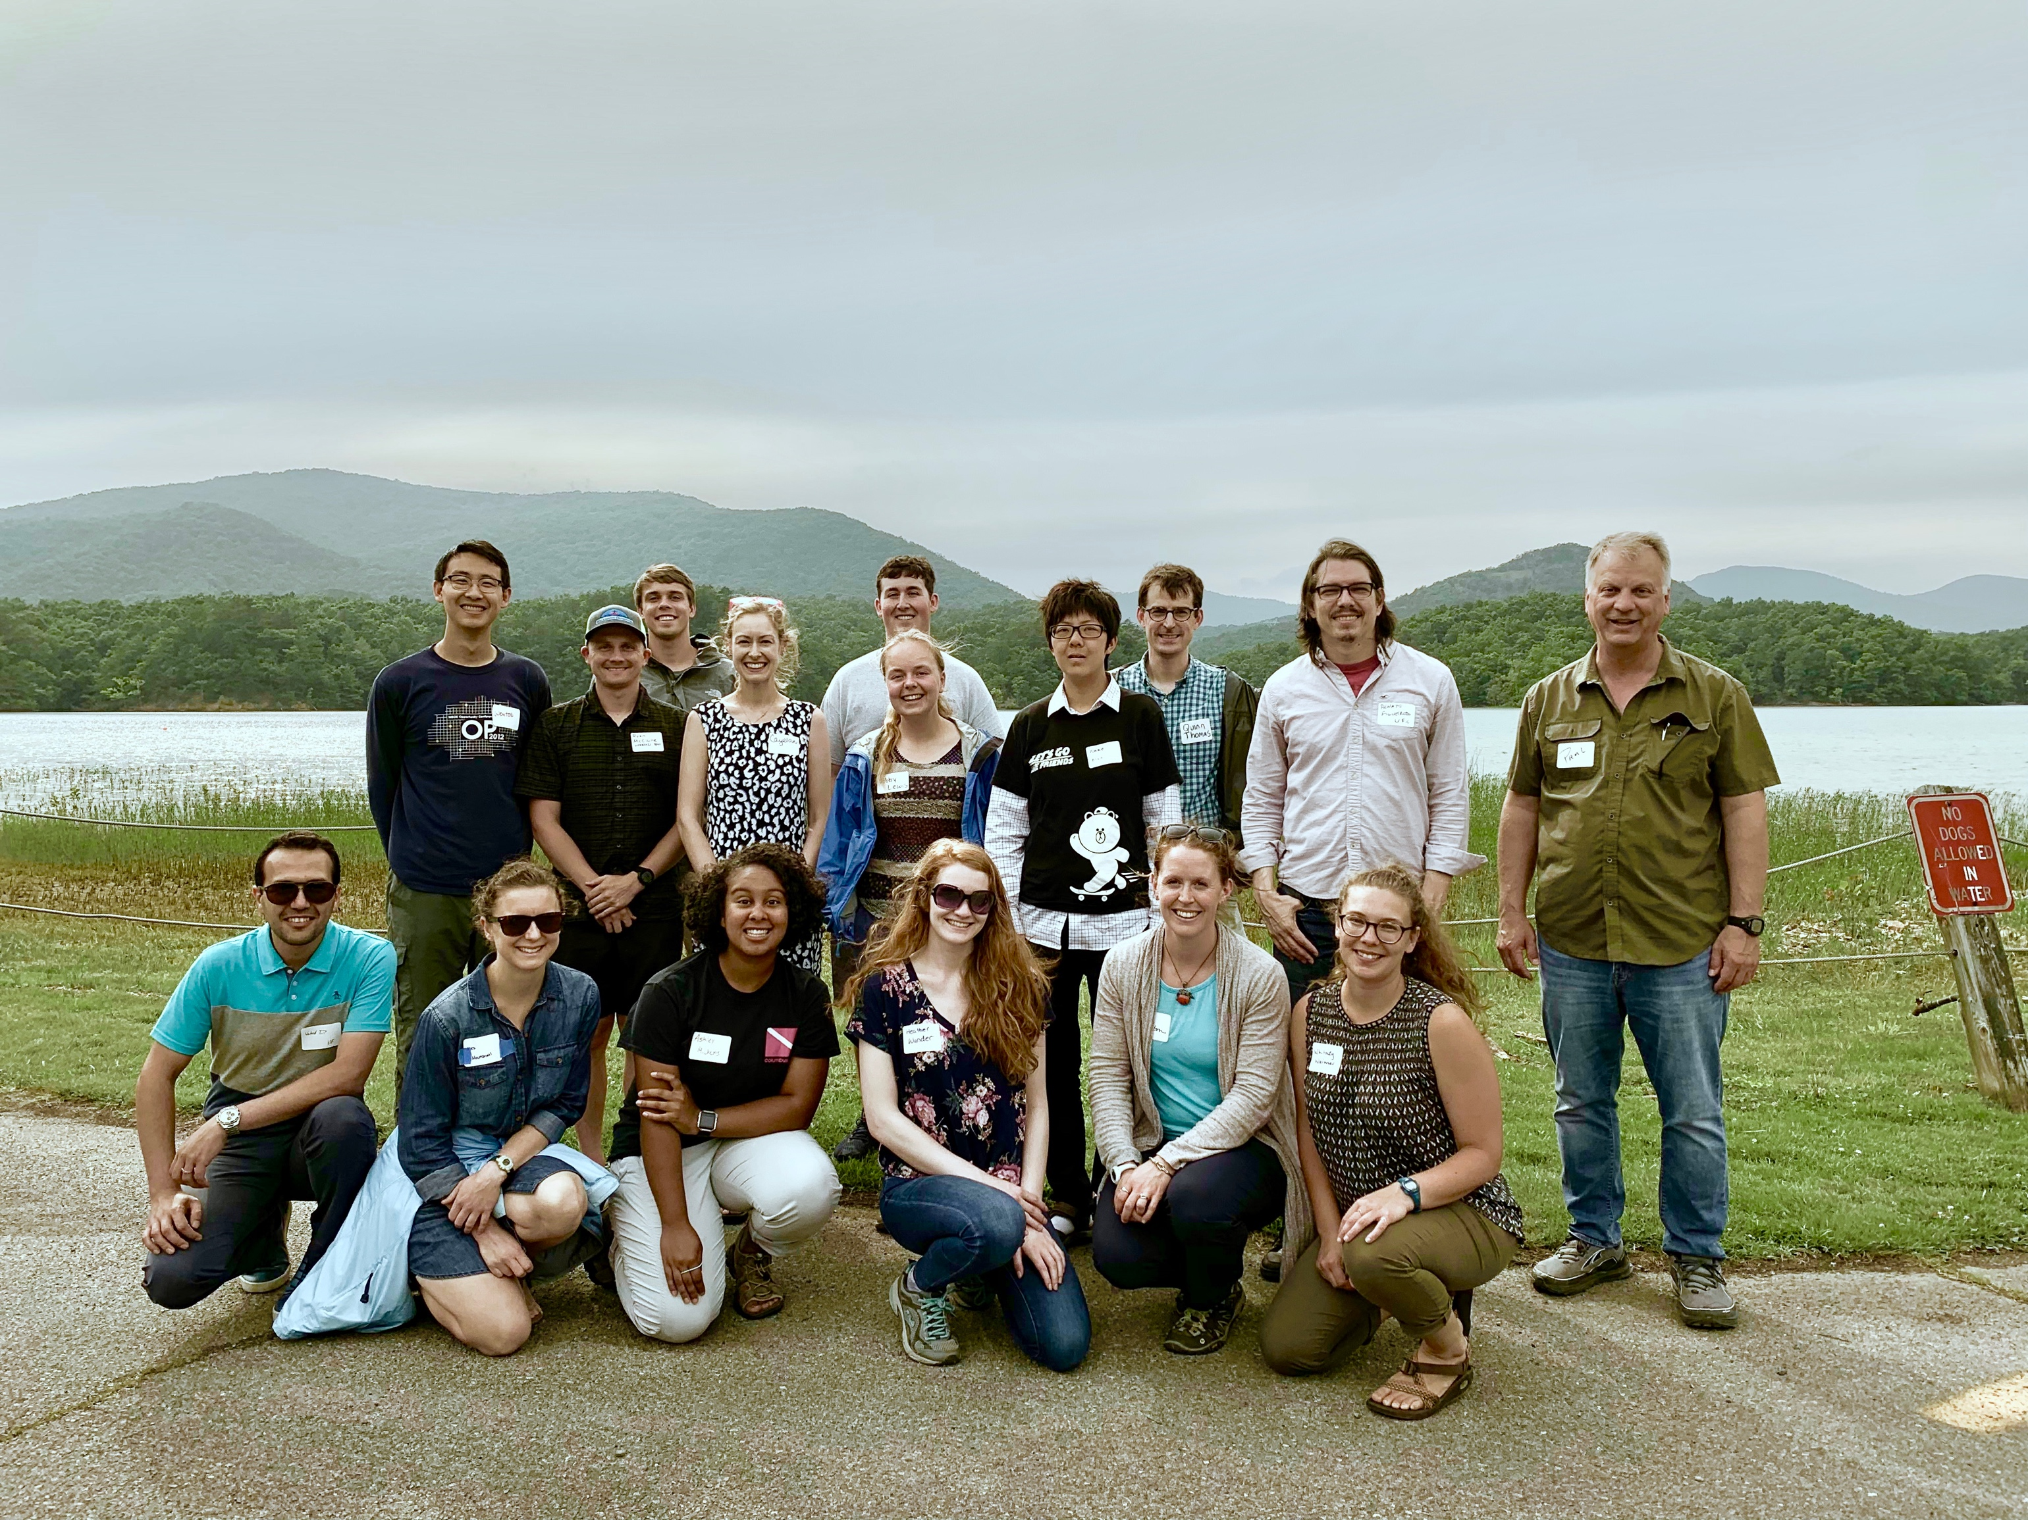


aslewis@vt.edu
@lewis_lakes
Notes:
I want to thank the Carey lab for collecting all of these data over the past six years, and the western Virginia water authority for allowing us to do work in their beautiful reservoirs. Thanks everyone for listening, and I’m happy to take any questions!

Slide 23
How accurately can we forecast bottom-water oxygen conditions two weeks into the future using only temperature and oxygen profiles?
How does the relative importance of temperature and oxygen as drivers of oxygen demand change over time?
Repeated hypothesis testing
Data-model fusion
Dynamic model parameters

Slide 24
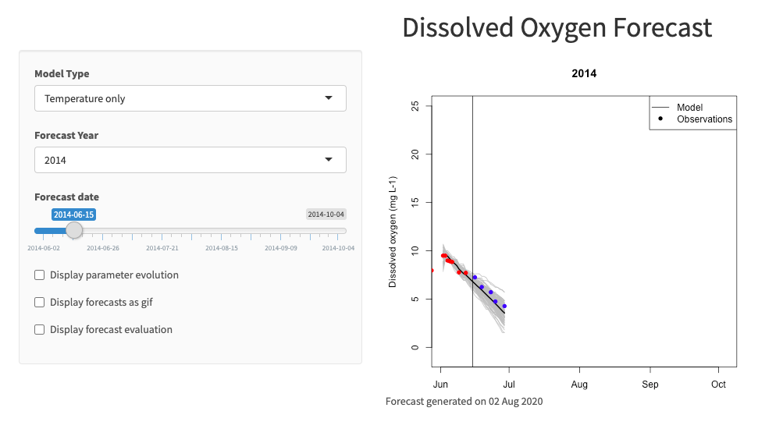
Interactive web portal facilitates potential management relevance
Notes:
Ultimately, my goal is that this framework can be used to create forecasts, not just hindcasts, to inform management of the reservoir. For that purpose, I have developed an interactive web portal that managers can use to visualize how forecasts have performed in the past and predictions for the future.

Slide 25
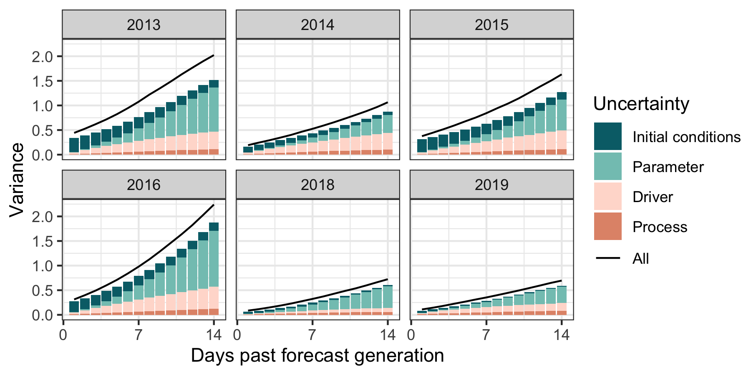
Missing pieces
Created NIEFs over 6 years of whole ecosystem oxygen manipulations
Full model uncertainty
Shiny
Alternative model structures
Conclusions
Notes:
Think about take homes here to support temp vs oxygen story w/o emphasizing partitioning

Slide 26
75% of human water use comes from rivers, lakes, and reservoirs
Reservoirs alone bury more carbon than ocean sediments each year
Notes:
My work is based in reservoirs are critical to understand for several reasons. First, reservoirs are important as a source of freshwater for people around the world. 75% of human water use comes from a combination of rivers, lakes, and reservoirs. Second, reservoirs play a critical role in the global carbon cycle. Each year, reservoirs around the world bury more organic carbon than all ocean sediments. This serves as an important and understudied ecological carbon sink.

Slide 27

More information is needed to determine how these factors interact in lakes and reservoirs
≠
Notes:
Finally, it is worth noting that most previous research that has been done on oxygen demand has been done in small-scale incubations, making it difficult to assess how these factors will interact on the scale of a whole reservoir.

Slide 28
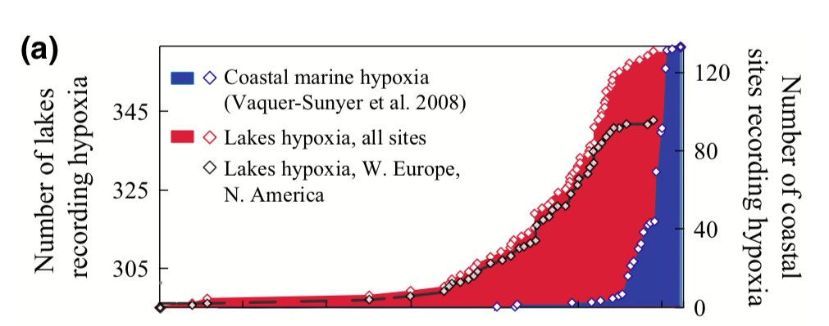
Jenny et al. (2016)

Slide 29
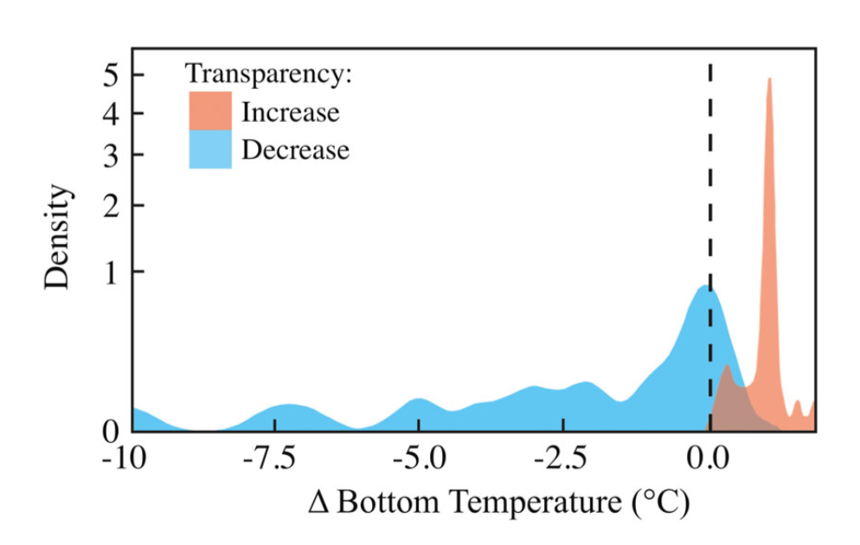
Heterogeneous global changes have led to uncertainty about future oxygen dynamics

Slide 30

Changes in climate and land use are driving heterogeneous trends in oxygen demand
O₂
O₂
O₂

